Slide 1

Home Appliance Automation using IoT
Experiment 2:
Navarro, Rod Geryk C.
CPE162P- 4 - E01

Slide 2
OBJECTIVES
1. To demonstrate how home appliance automation works using IoT (Internet of Things): - This project aims to show how household appliances—like lights, fans, or alarms—can be controlled remotely through the internet.
2. To apply knowledge learned in Logic Circuits and Switching Theory, Microprocessors, CPE160P, and CPE161P courses: - This project will serve as a hands-on application of the concepts and skills learned from various computer engineering subjects.
3. To implement an embedded system integrated with IoT using an Arduino kit: - The project will use an ESP32 Dev Module as the core of the embedded system. It will read input from sensors, process the data, and control output devices.
4. To use ThingSpeak for data collection, monitoring, and analysis: - ThingSpeak, a cloud-based platform, will be used to collect sensor data, visualize it through graphs, and analyze trends over time.

Slide 3
MATERIALS
Arduino Kit
Laptop
ESP32 Dev Module - x1
LED – x1
220 ohm Resistor – x1
IR Sensor - x1
IR Remote –x1
Stepper Motor – x1
Motor Module – x1

Slide 4
INTRODUCTION
This project shows how home appliances like lights, fans, or alarms can be controlled remotely using the Internet of Things. It uses the ESP32 microcontroller to read data from sensors and control devices automatically. Students will apply what they learned in logic circuits, microprocessors, and embedded systems courses like CPE160P and CPE161P. The project also uses ThingSpeak to collect and analyze sensor data through online graphs and tools.

Slide 5
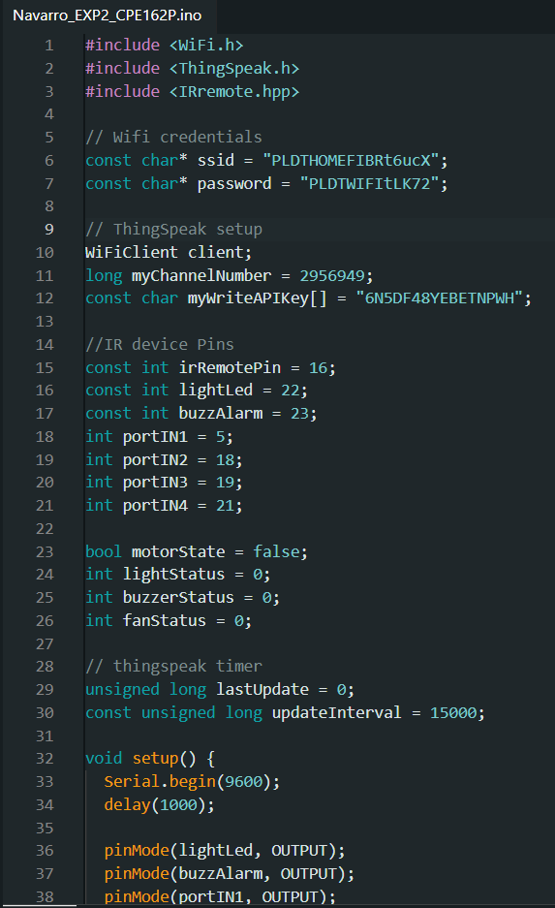
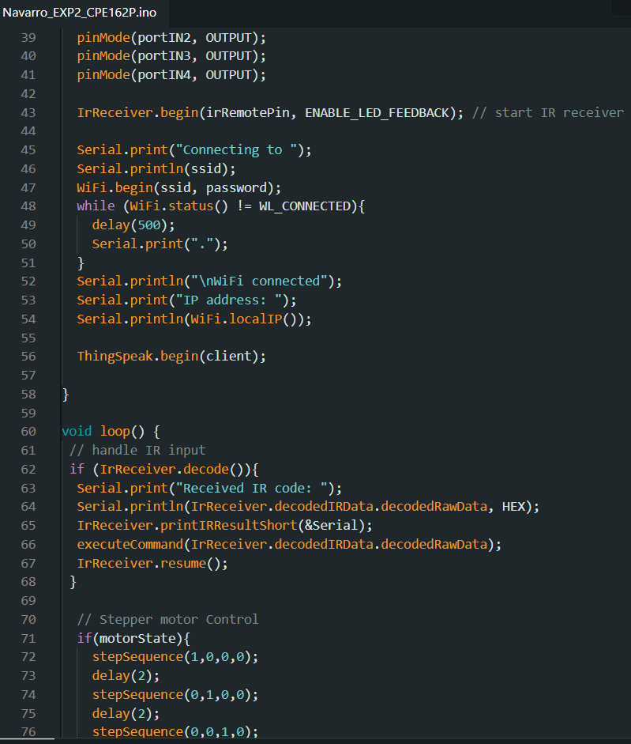
SOFTWARE DISCUSSION

Slide 6
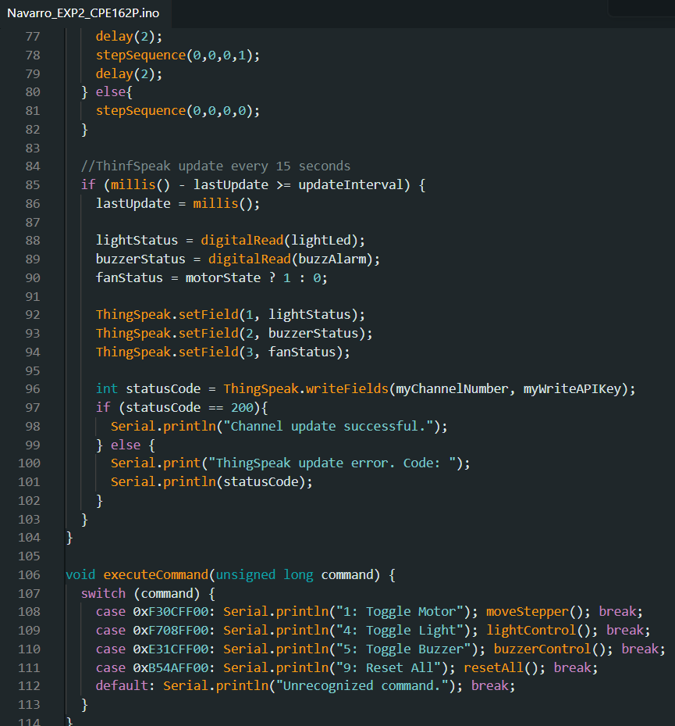
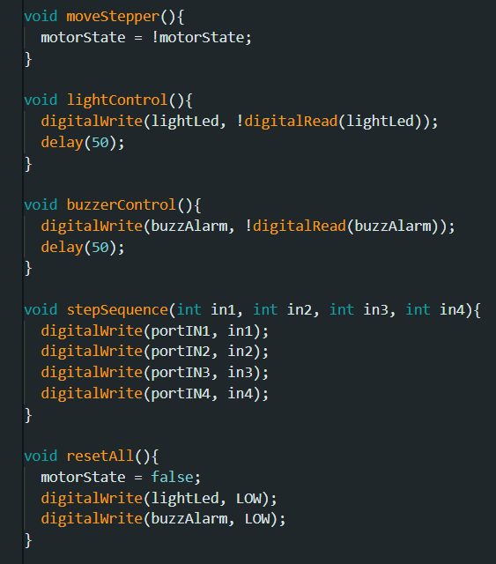
SOFTWARE DISCUSSION

Slide 7
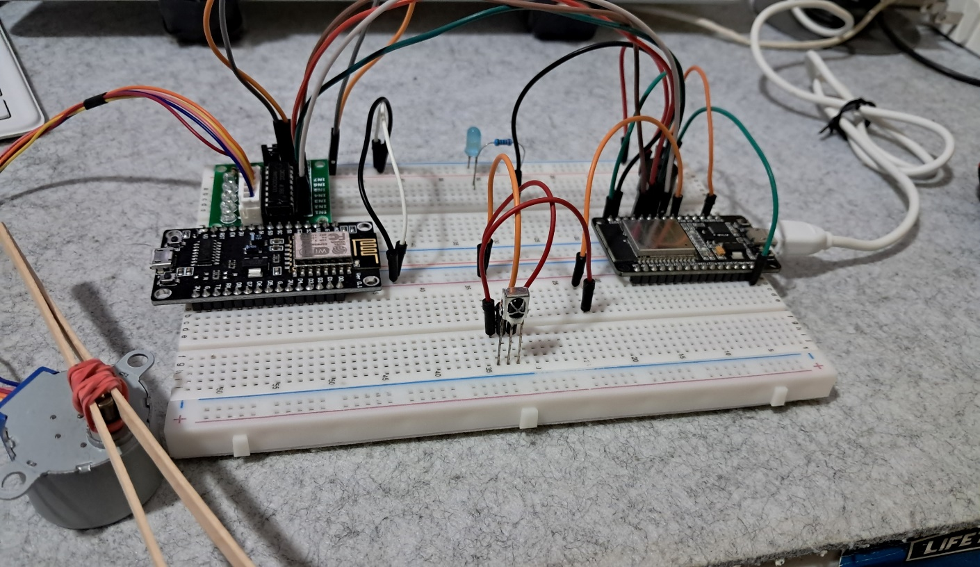
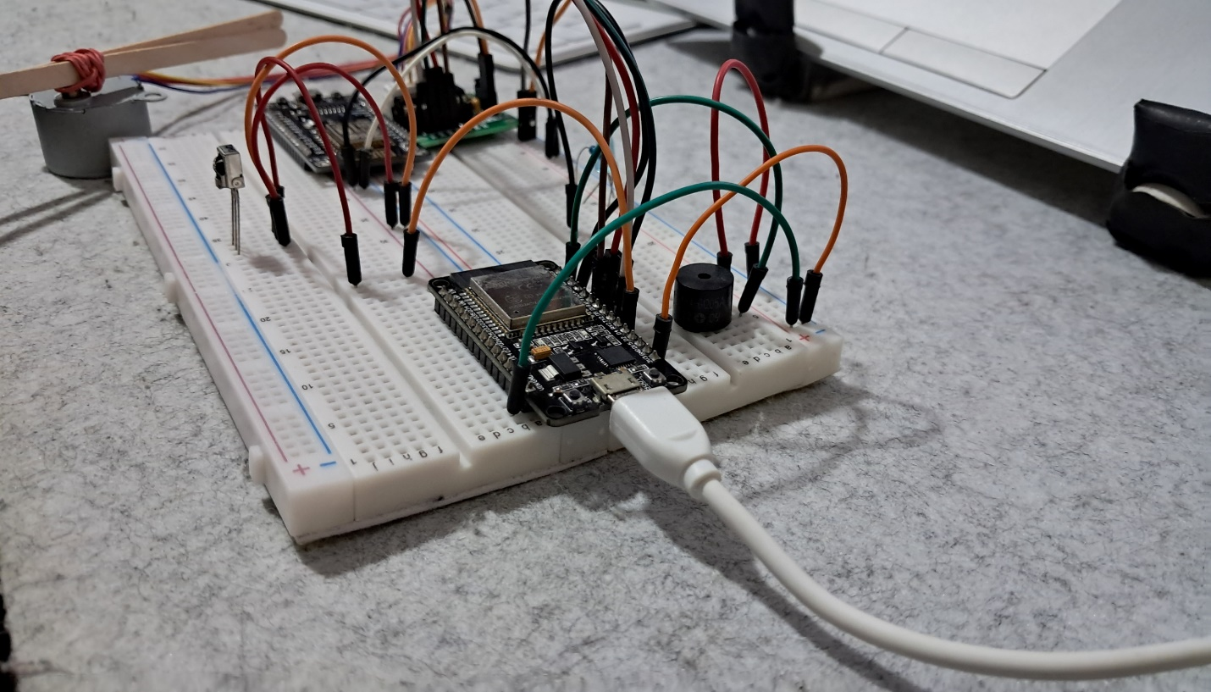
HARDWARE DISCUSSION

Slide 8
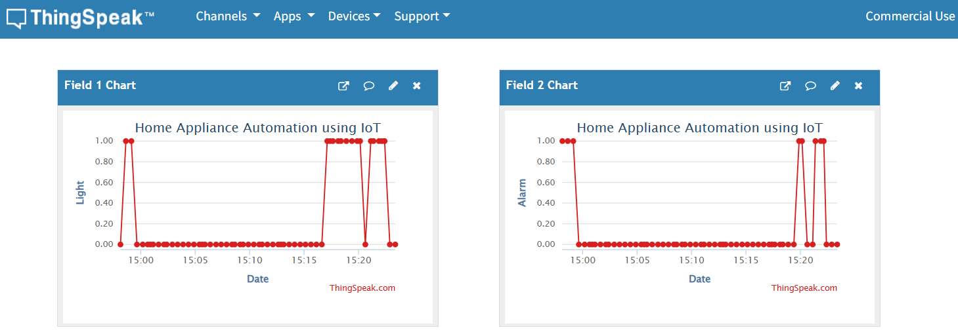
SAMPLE OUTPUT

Slide 9
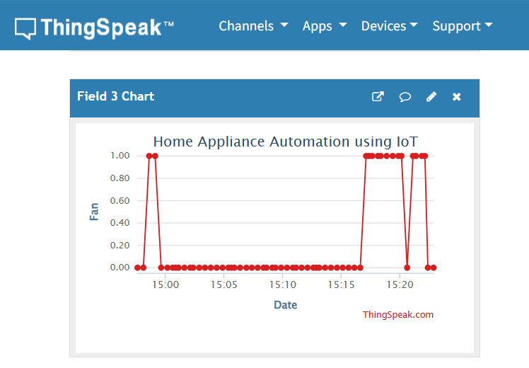
SAMPLE OUTPUT

Slide 10
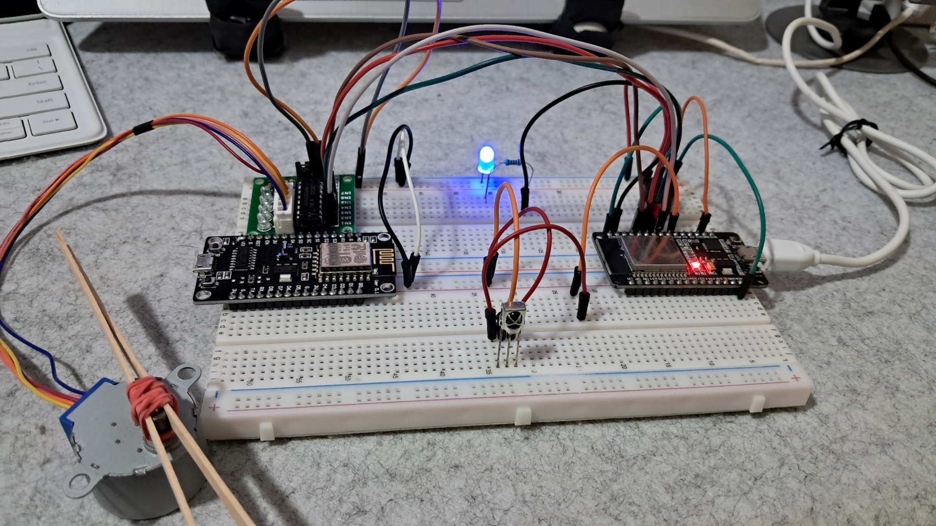
SAMPLE OUTPUT

Slide 11
DEMO VIDEO
Please click the link below for the Video Demonstration of EXP2:
https://youtu.be/4zrIQ8H9TT8?si=q1hm1QhJJeQ12dw0

Slide 12
THANK YOU!

